Slide 1



CPU Scheduling using C
Made by Team Electrocube
Himaneesh Singh
Nikhil Saini
Shambhav Chaudhary
Srivatsan Karthikeyan

Slide 2




Brief Description
Problem Statement: The Scheduler’s Path
Through this PowerPoint Presentation, we have tried to explain the different types of Algorithms we have implemented through Code with the help of C Programming Language. We show the output we have obtained when we implemented the code. The Problem Statement gave us 3 algorithms and we also implemented 3 extra algorithms on our own which have not been mentioned in the Problem Statement itself.

Slide 3
CPU Scheduling
CPU Scheduling is the method used by the operating system to decide which process gets the CPU and when, when multiple processes are ready to execute.
Since the CPU can execute only one process at a time, the OS must schedule them efficiently.
Why we need CPU Scheduling?
Multiple Programs run at the same time.
To avoid CPU being idle.
To Improve Performance and User Experience

Slide 4
Algorithms Implemented
Problem Statement Algorithms:
First Come First Serve (FCFS)
Shortest Job First (SJF)
Round Robin (RR)
Algorithms Implemented on our Own:
Shortest Remaining Job First (SRJF)
Longest Job First (LJF)
Multi-Level Queue (MLQ)

Slide 5
Algorithms Explained (Problem Statement)
First Come First Serve (FCFS): FCFS stands for First Come First Served (FCFS). First Come First Served (FCFS) is the simplest type of algorithm. It is a non-preemptive algorithm i.e. the process cannot be interrupted once it starts executing. The FCFS is implemented with the help of a FIFO queue. The processes are put into the ready queue in the order of their arrival time.
Shortest Job First (SJF): SJF stands for Shortest Job First (SJF). Shortest Job First (SJF) Scheduling Algorithm is based upon the burst time of the process. The processes are put into the ready queue based on their burst times. In this algorithm, the process with the least burst time is processed first.
Round Robin (RR): Round Robin is a CPU scheduling algorithm where each process is cyclically assigned a fixed time slot. It is the preemptive version of the First come First Serve CPU Scheduling algorithm.

Slide 6
Algorithms Explained (Own Initiative)
Shortest Remaining Job First (SRJF): The pre-emptive version of Shortest Job First (SJF) scheduling is called Shortest Remaining Job First (SRJF). In SRJF, the process with the least time left to finish is selected to run. The running process continues until it finishes or a new process with a shorter remaining time arrives, ensuring the fastest finishing process always gets priority.
Longest Job First (LJF): Longest Job First (LJF) is a non-preemptive scheduling algorithm. This algorithm is based on the burst time of the processes. The processes are put into the ready queue based on their burst times i.e., in descending order of the burst times. As the name suggests this algorithm is based on the fact that the process with the largest burst time is processed first. The burst time of only those processes is considered that have arrived in the system until that time.
Multi-Level Queue (MLQ): Multilevel Queue (MLQ) CPU scheduling is a type of scheduling that is applied at the operating system level with the aim of sectioning types of processes and then being able to manage them properly. As with the MQ Series, processes are grouped into several queues using MLQ based on known parameters such as priority, memory, or type. Every queue has its scheduling policy and processes that are in the same queue are very similar too.

Slide 7


Slide 8
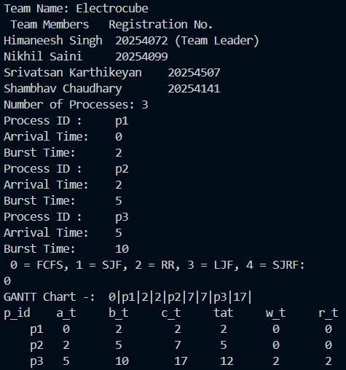
First Come First Serve (FCFS)

Slide 9
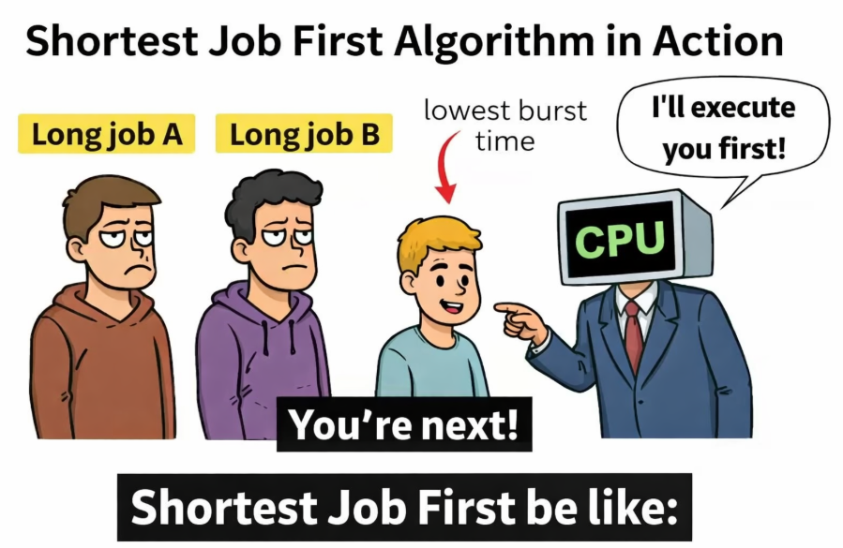

Slide 10
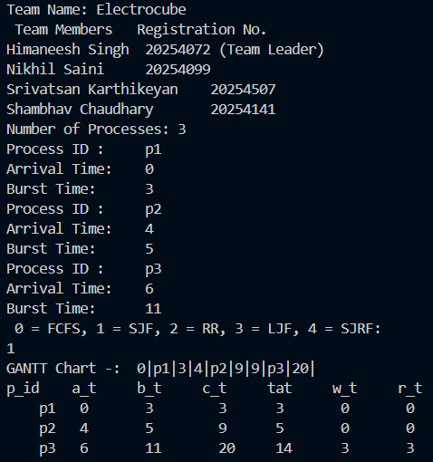
Shortest Job First (SJF)

Slide 11
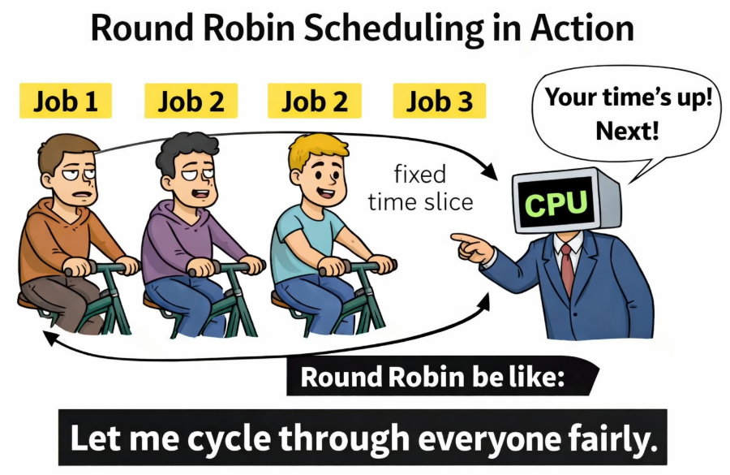

Slide 12
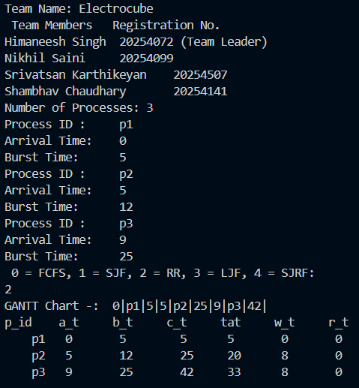
Round Robin (RR)

Slide 13
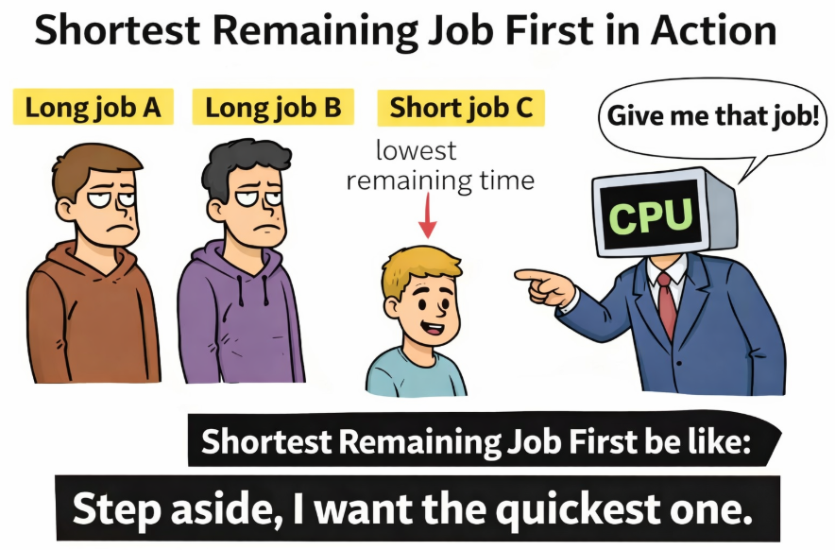

Slide 14
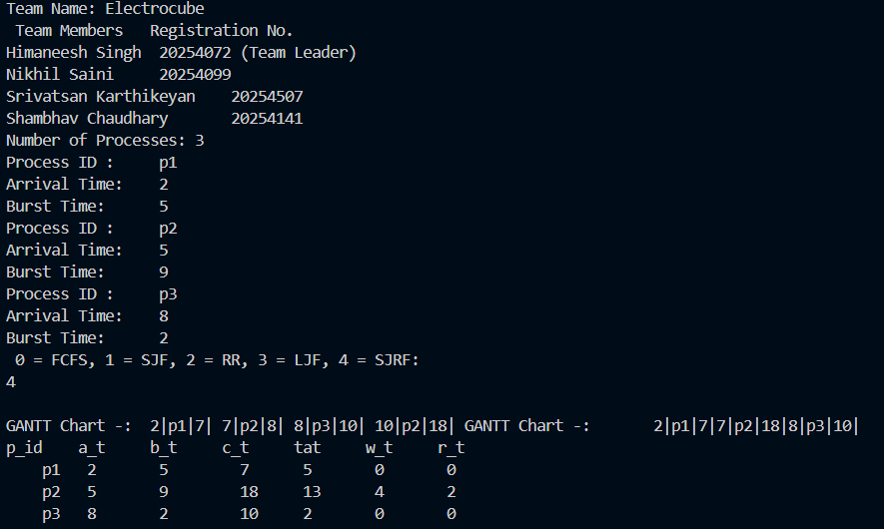
Shortest Remaining Job First (SRJF)

Slide 15
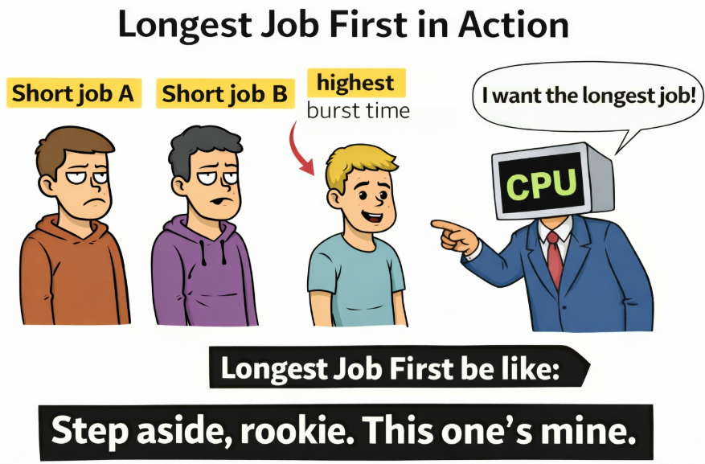

Slide 16
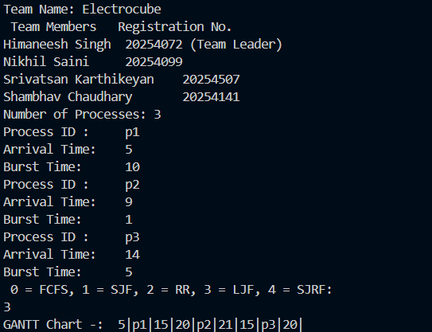
Longest Job First (LJF)

Slide 17


Slide 18
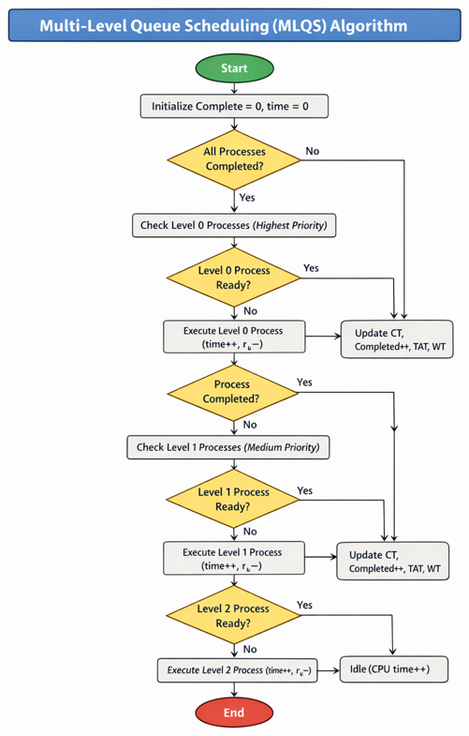
Multi-Level Queue (MLQ) Flowchart

Slide 19
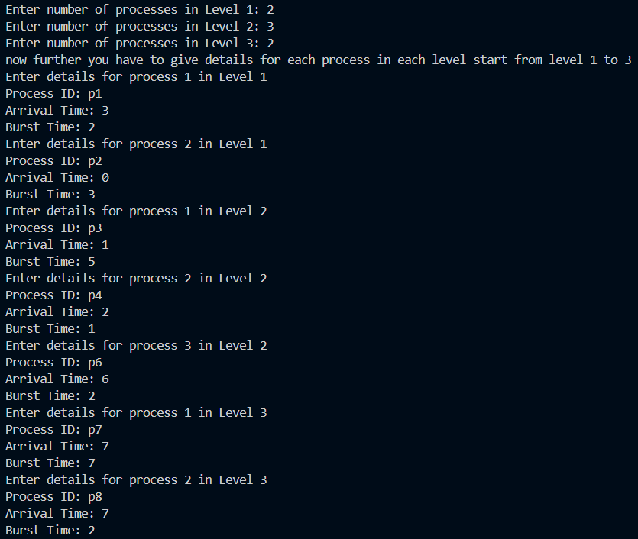
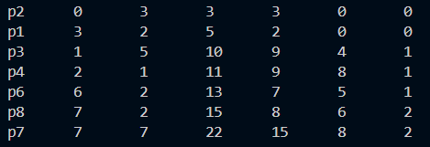
Multi-Level Queue (MLQ)

Slide 20
References
https://www.geeksforgeeks.org/
https://chatgpt.com/

Slide 21

